Slide 1

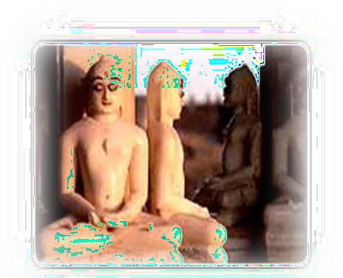
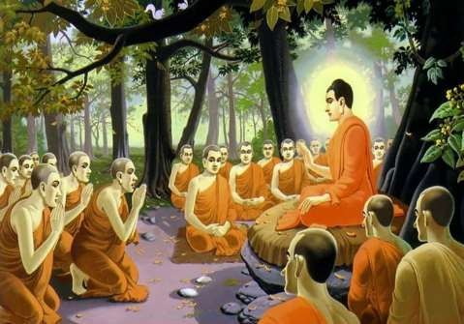
–
Tanushree Sanwal, Assistant Professor, KIET

Slide 2

BUDDHISM
BUDDHISM

Slide 3
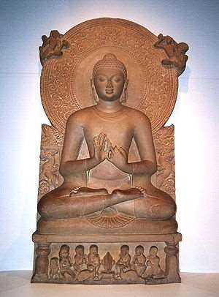
Origins
Around 530 BC a young prince named Siddhartha Gautama challenged the ideas of the Brahmin priests and created a new world religion .
Born in 563 BC into the warrior
caste
He lived in luxury in his family’s palaces and never experienced pain, suffering, or death
He married a beautiful woman
and they had a son.

Slide 4
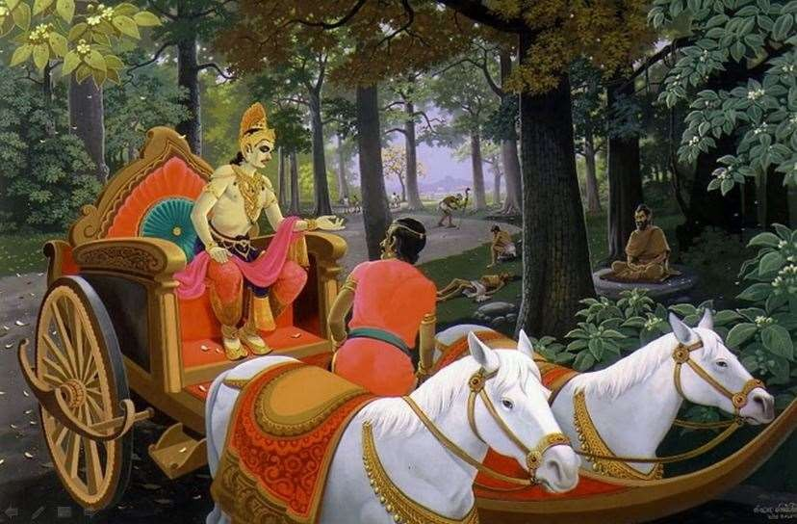
One day while riding in his chariot outside the palace walls, Gautama saw a sick man, an old man, and a dead man.
He realized that life was an endless cycle of pain and that the only way to escape that cycle was to seek wisdom
He left his family when he was about 29 and became a homeless wanderer with five other men who were also seeking wisdom.

Slide 5
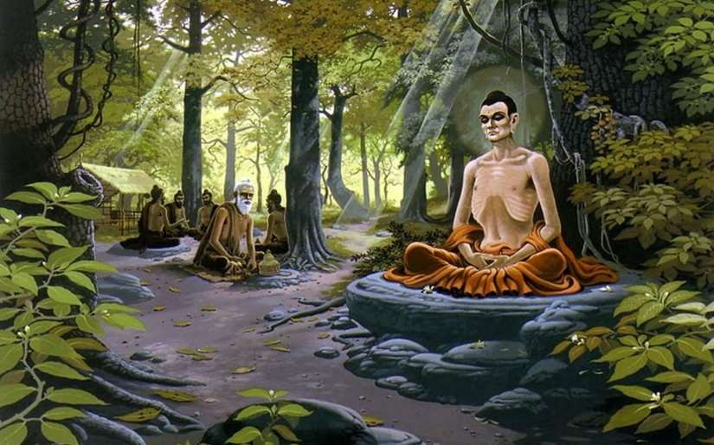
Gautama tried to find wisdom through physical suffering and
harsh discipline but instead he gained only pain.
At last, after days of meditating deeply in the shade of a tree, Gautama felt that the truth had come to him
At this point, he became to known as “The Enlightened One,” or
Buddha.

Slide 6

Four Noble Truths
First Noble Truth: Everything in life is suffering and sorrow.
Second Noble Truth: The cause of all this pain is people’s self-centered cravings and desires --- people seek pleasure that cannot last and that leads only to rebirth and more suffering.
Third Noble Truth: The way to end all pain is to end all desires.
Fourth Noble Truth: People can overcome their desires and attain enlightenment by following the Eightfold Path .

Slide 7

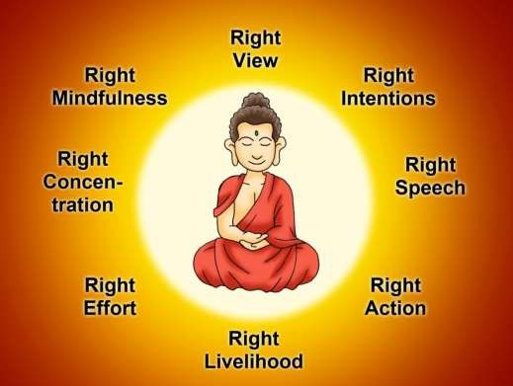
Noble Eightfold Path
He gave an Eightfold path. According to him the eightfold path is a way to end suffering.
Right view
Right intention
Right speech
Right action
Right livelihood
Right effort
Right mindfulness
Right meditation or concentration
By following the Eightfold Path, anyone could attain nirvana-- which was the release from all pain and suffering.

Slide 8
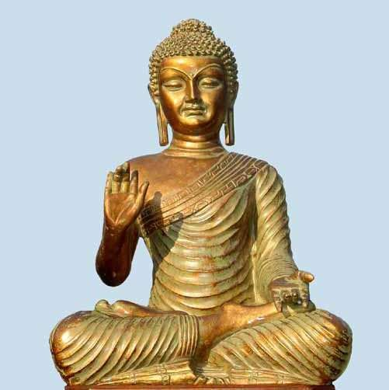
Buddha taught his followers to treat all living things (humans, animals, and even insects) with kindness and love.
Buddha eliminated the caste system, the rituals associated with Hinduism, and the ancient language (Sanskrit) of the Vedas and Upanishads.
Concerned with all human beings---women as well as men, and lowborn as well as highborn .

Slide 9
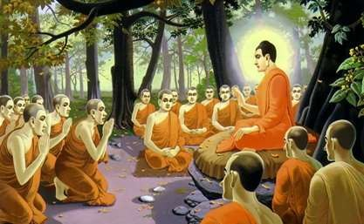
Refuge in the Three Jewels
Three things that Buddhists give themselves to, and in return look toward for guidance, in the process known as taking refuge.
Buddha – example of Buddha Or more loosely, the wisdom that
understands Dharma, and in this regard the Buddha represents the perfect wisdo that sees reality in its true form.
Dharma – teachings/laws as
expounded by Buddha
Sangha – community of those who
will help others attain bodhi
(enlightenment).
m

Slide 10

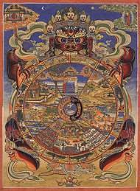
The most important symbol in Buddhism is the Wheel of Life which depicts the cycle of birth and life.
The eight spokes symbolize the Eightfold Path.
Buddhist teachings & beliefs were recorded in a
collection called the Tripitaka.

Slide 11


Pali Canon (Tipitaka):
Vinaya Pitaka: dealing with rules for monks and nuns
Sutta Pitaka: discourses, mostly ascribed to the Buddha, but some to disciples
Abhidhamma Pitaka: variously described as philosophy, psychology, metaphysics.
Pali Canon is the scripture collection
of the Theraveda Buddhist
tradition.
In Pali language-
Pitaka means basket
tipitaka means three basket.

Slide 12

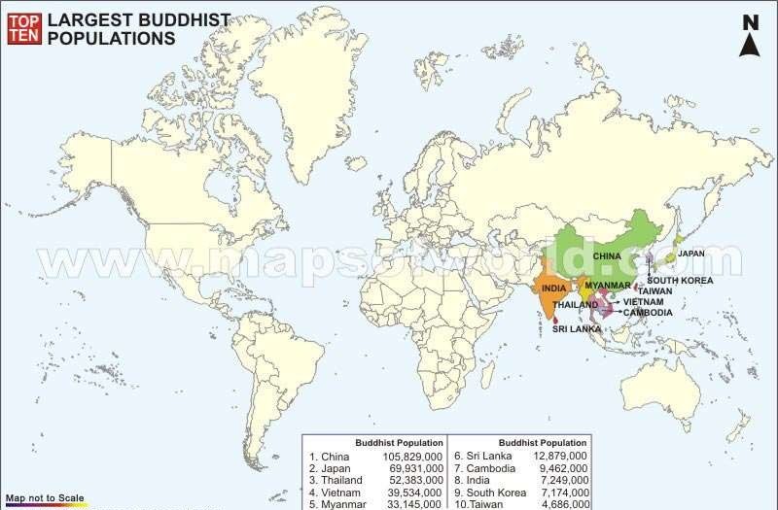

Slide 13
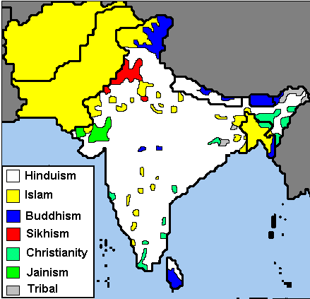
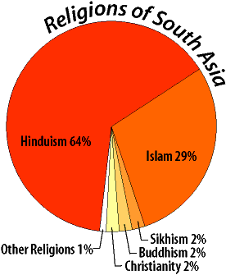

Slide 14

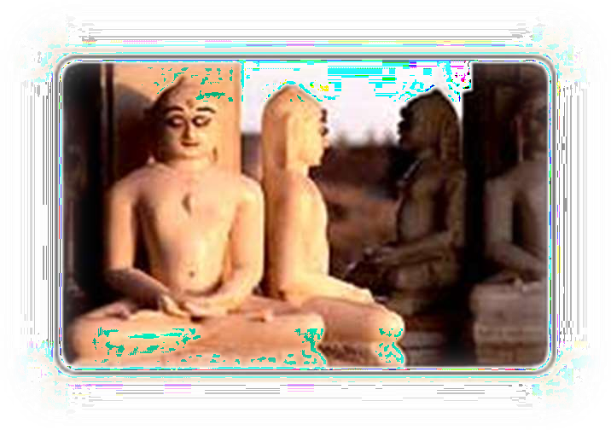

Slide 15

◻ Jainism is a way of life and one of the oldest religions
of the world.
◻ It believes in a cyclical nature of universe. It discourages superstition and blind faith and encourages free and rational thinking.
◻ Jainism lays heavy emphasis on non-violence (ahimsa)
and discipline.
◻ According to Jain philosophy, all Tirthankaras were born as human beings but they have attained a state of perfection or enlightenment through meditation and
self realization. They are the “Gods” of Jains.
◻ Jains have always practiced non-violence, vegetarianism, meditation, yoga, and environmentalism.

Slide 16











Not to cause harm to any living beings by thoughts, speech or body
Non-violence towards all living creatures, in both thought
and action
Strengthens autonomy of thoughts & speech, and non-possessiveness
Non-violence (Ahimsa)
Multiplicity of Views (Anekäntväd)
Non-Possessiveness
/ Non-Attachment (Aparigraha)
A complete detachment from people, places, and material things
Truthfulness
(Satya)
To speak the harmless truth only
Non-Stealing (Asteya / Achaurya)
Not to take anything that is not properly given

Slide 17
◻ Jainism believes in Godhood but does not believe God to be the First Cause. God is not a Creator, Preserver or Destroyer of the universe.
◻ “God” does not Punish or Reward
Each person is responsible for improving life by one’s self-endeavor
Each person is capable of achieving Godhood
◻ All Living Beings have Souls & are Equal
All life is sacred
Therefore, living in peace & harmony is essential
◻ Elimination of our Karmas is the Path to Liberation & Achievement of Godhood
It requires multiple re-births
◻ Ultimate Goal of Life
To be free from all karma

Slide 18

◻ The principles governing the successions of life cycles (birth, life, and death) is Karma.
The Theory of Karma is founded on the simple law of cause and effect. What we experience now is the result of our own past action and our future is a function of our own choice and making.
Explains the role that karmas play in our lives, how we accumulate karmas, and how we get rid of them.
Actions of mind, speech, and body bind us with karma and our intentions and the passions determine the duration, strength and the results of the bondage.

Slide 19

◻ Lord Mahavir - 24th (and final) Tirthankara
◻ Born on March 30, 599 B.C. (about 2600 years ago) as a prince in Bihar, India. He attained nirvana in the year 527 B.C. at the age of 72.
◻ The ultimate objective of his teaching is how one can attain the total freedom from the cycle of birth, life, and death, and achieve the permanent blissful state (known as liberation, nirvana, absolute freedom, or Moksha.)
◻ He shaped the present form of Jainism. Lord Mahavir envisioned men and women to be on equal footing in the matters of spiritual advancement.

Slide 20



Digit of moon – (region of liberated souls)
Three dots – (Right Perception/Faith, Right Knowledge, and Right Conduct)
Overall meaning – After removing all of their karmas, living beings will reside in the world of liberated souls.
Palm – signifies assurance; to have faith and change the path of righteousness.
Wheel of Dharma – 24 spokes represent the 24 Tirthankaras. The word inside the wheel is ahimsa.

Slide 21
◻ Mahavir Jayanti – celebration of the birth of Lord Mahavir
◻ Paryushan Parva – festival of forgiveness
◻ Samvatsari Pratikraman – 3 hour prayer to ask for forgiveness
◻ Mahavir Nirvan – celebration at Diwali/New Year’s per the lunar calendar

Slide 22

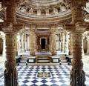
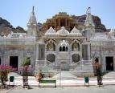
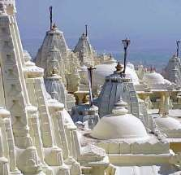



The idols of the 24 Tirthankaras are the same because they represent the quality and virtues of the Tirthankaras, not the physical body. A unique symbol at the bottom of each idol differentiates them.

Slide 23







All souls are equal
Non-Violence
Multiplicity of views Non-possessiveness Karma
Three jewels: Right Knowledge, Right Faith, Right Conduct

Slide 24

◻ Code of Conduct for Monks & Nuns (stricter)
◻ Code for Laymen and Laywomen
◻ Vegetarianism & Non-Violent Practices
No Silk, Leather, Animal Products
Simplicity of Lifestyle, Non-Materialism
◻ Meditation and Introspection
◻ Forgiveness is a Moral Doctrine
◻ Compassion, Charity & Community Service
◻ Preservation of the Environment
Jainism is the World’s Only Religion Emphasizing the
Environment

Slide 25


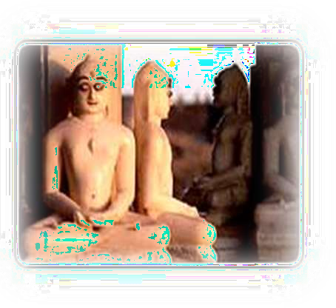





Control anger through forgiveness
Arrogance through humility
Deception through honesty Greed through contentment
Major emphasis in Jainism is on non-
violence (Ahimsa)

Slide 26


